Slide 1

Introduction to Extensive Form Games (pt 2)
Chris Kiekintveld

Slide 2
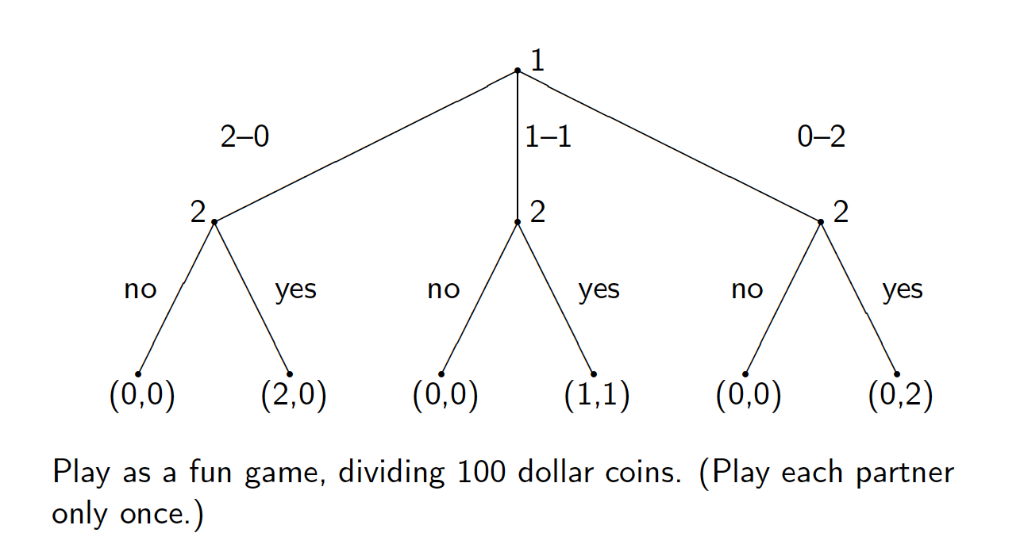
Example: Sharing Game

Slide 3
Pure Strategies
How many pure strategies does each player have in the sharing game?

Slide 4
Pure Strategies
How many pure strategies does each player have in the sharing game?
Player 1: 3; Player 2: 8

Slide 5
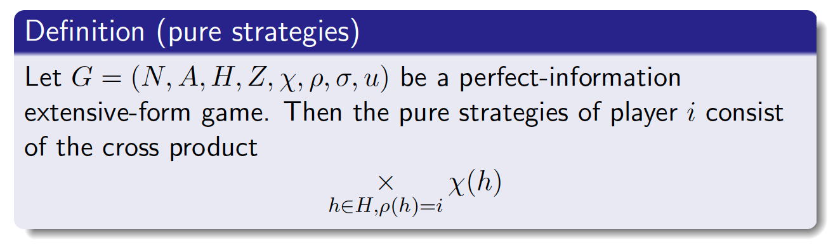
Pure Strategies
How many pure strategies does each player have in the sharing game?
Player 1: 3; Player 2: 8
A pure strategy for a player in a perfect information game is a complete specification of which deterministic action to choose at every decision node belonging to that player

Slide 6
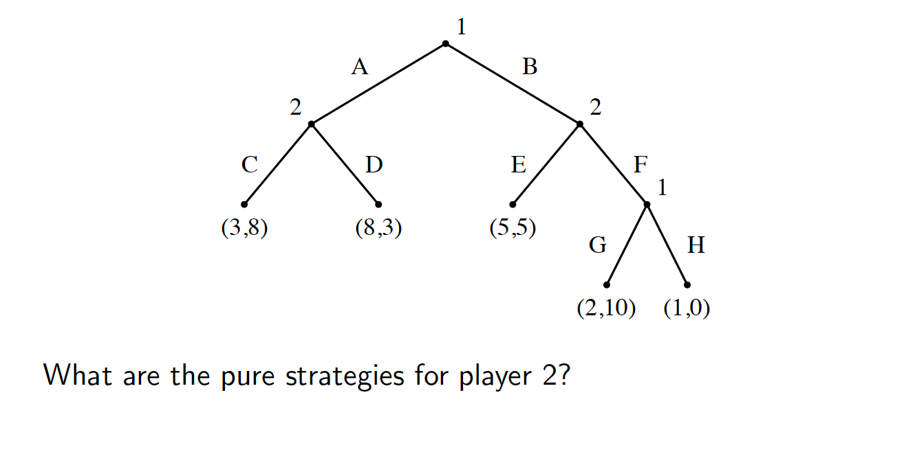
Pure Strategies Example

Slide 7
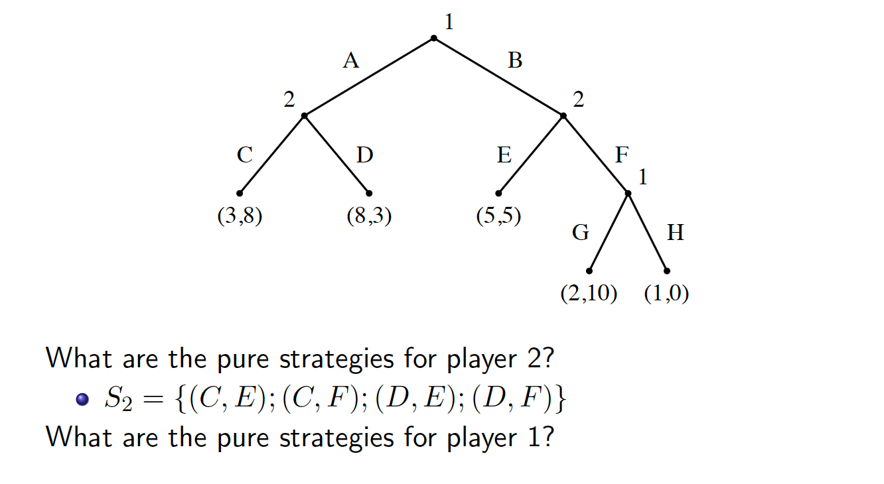
Pure Strategies Example

Slide 8
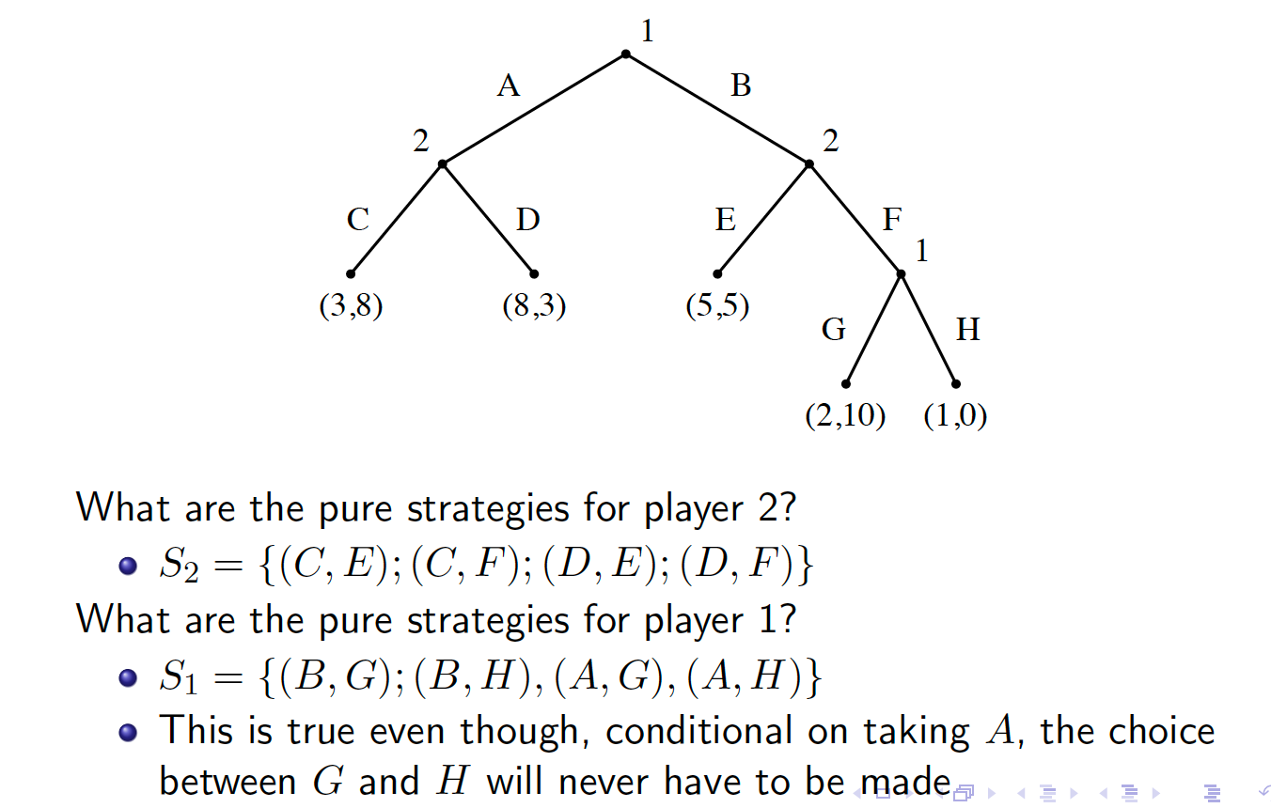
Pure Strategies Example

Slide 9
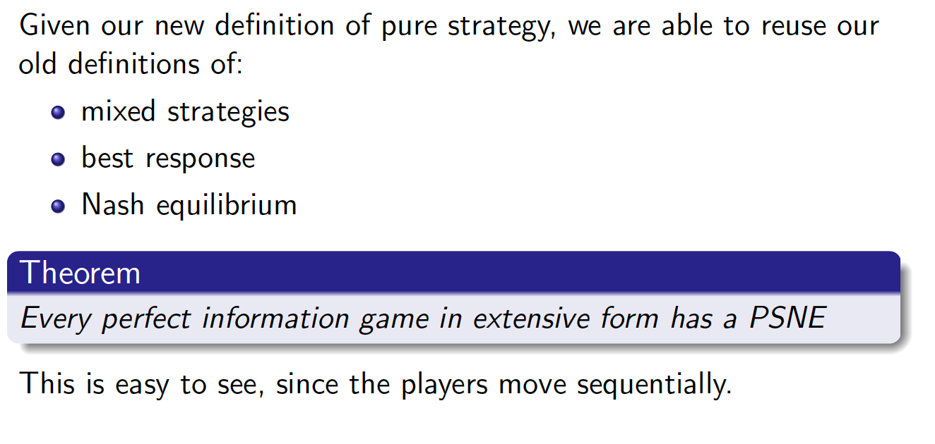
Nash Equilibria

Slide 10
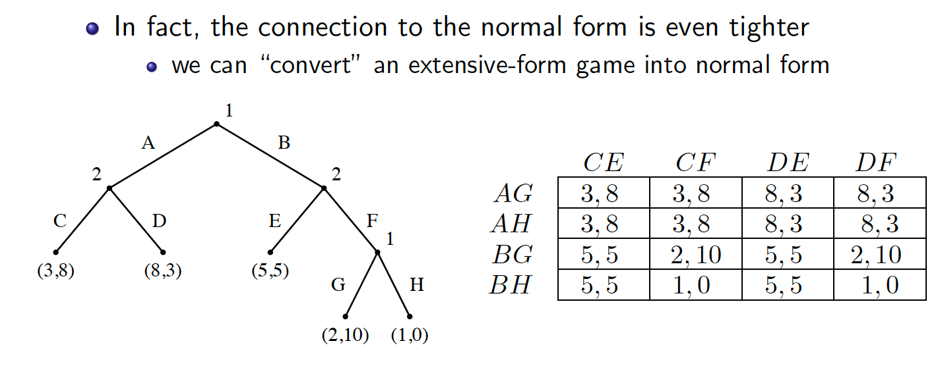
Induced Normal Form

Slide 11
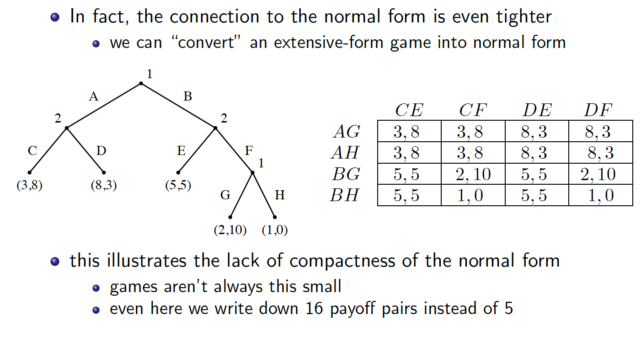
Induced Normal Form

Slide 12
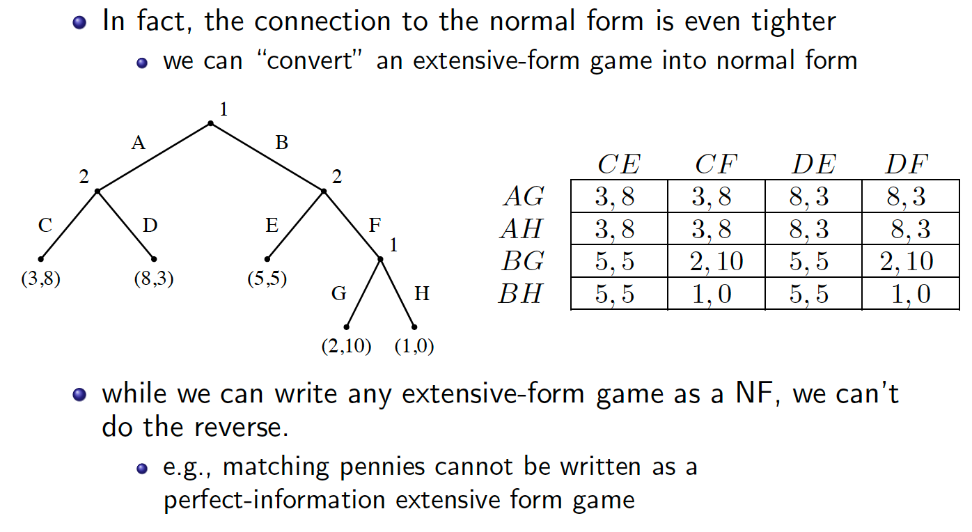
Induced Normal Form

Slide 13
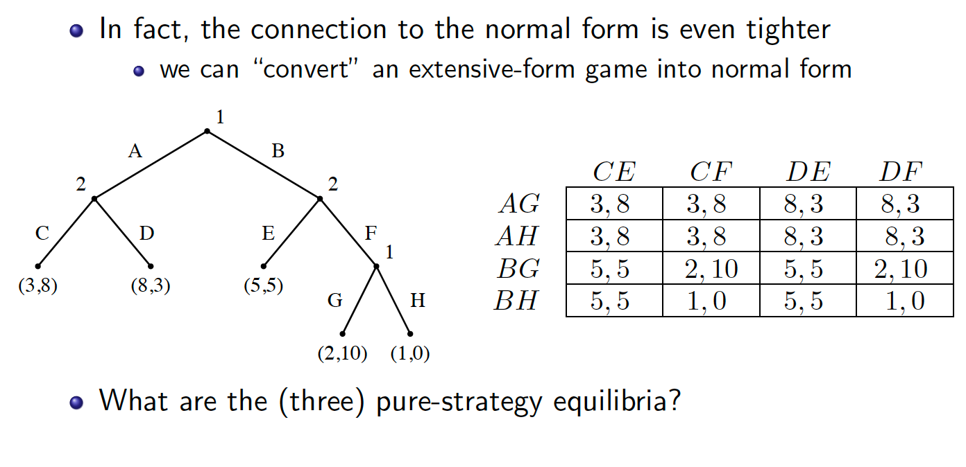
Induced Normal Form

Slide 14
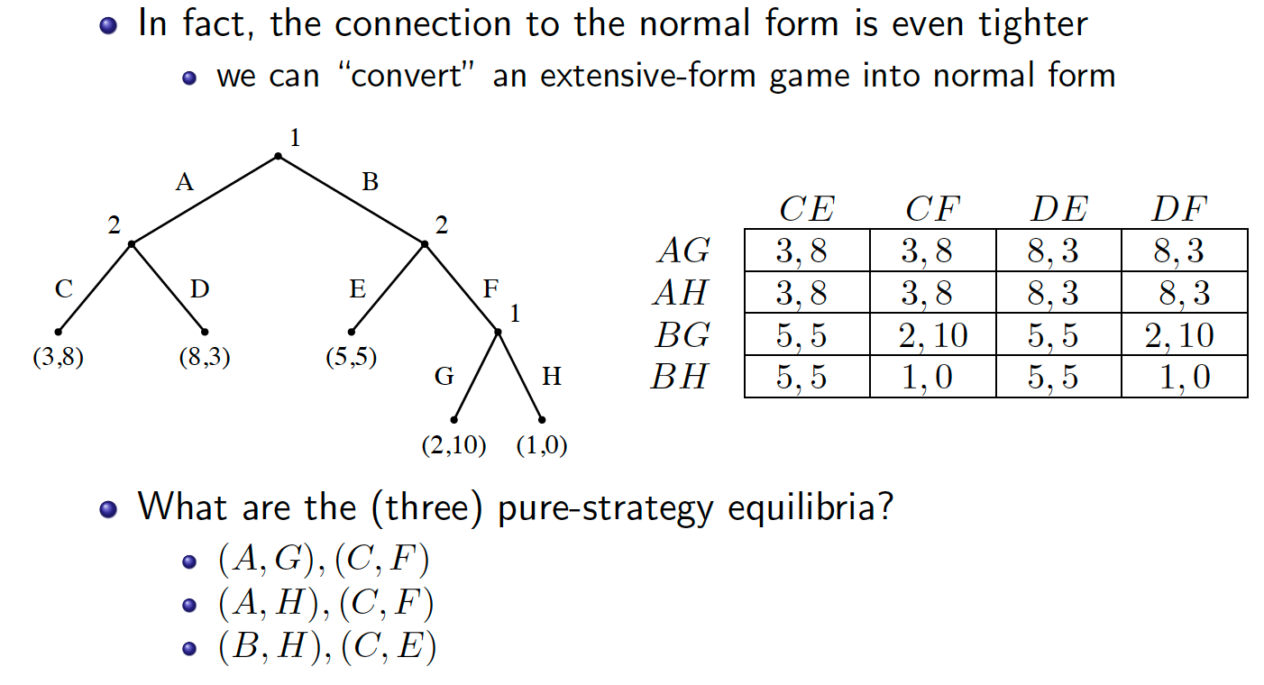
Induced Normal Form

